Slide 1
Aims
To develop an observing strategy capable of imaging galaxies during the EoR and determining their redshifts.
This strategy will be based upon current experimental approaches and ultimately predictions provided by the Predictions Subgroup.

Slide 2
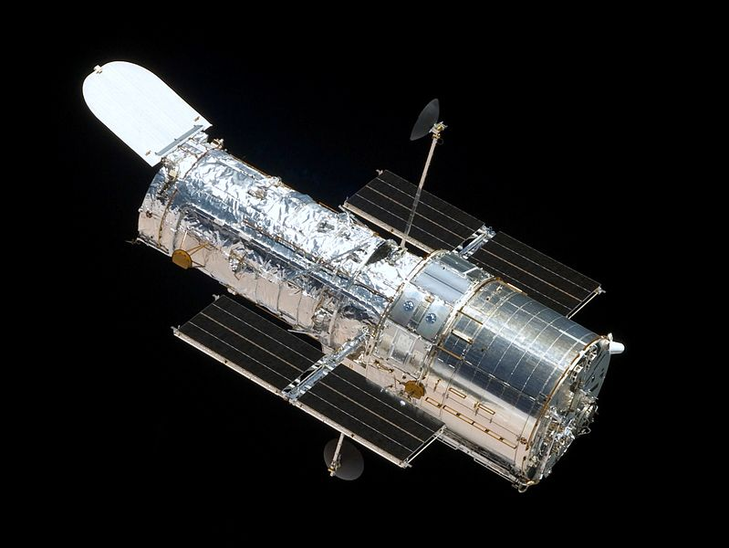

Slide 3
Progress so far
Researched current observational limits
Identified possible space-based telescopes: HST, JWST, Spitzer
Calculated exposure times to provide comparison
Researched gravitational lensing
Researched filters

Slide 4
Hubble Space Telescope (HST)
Launched April 1990 into a low earth orbit
Diameter: 2.4m
Observation range: UV – IR
Field of View: 16728 arcsec²
Advantages:
Currently in orbit
Has discovered candidates many candidates - up to z≈11.9
(UDFJ-39546284)
Disadvantages:
Not optimised for IR – OTA not designed as such e.g. mirrors too warm.
In demand – difficult to get observing time (1/5 proposals successful)
Will likely be brought down soon – This year?
Notes:
Data has been used in approximately 10,000 papers.
Reduced the error on Ho from 50% to 10%.
HST data generates 15times as many citations as a 4m Ground based telescope (Herschel).
UDFJ-39546284 oldest stellar structure discovered– thought to be mini-galaxy.

Slide 5
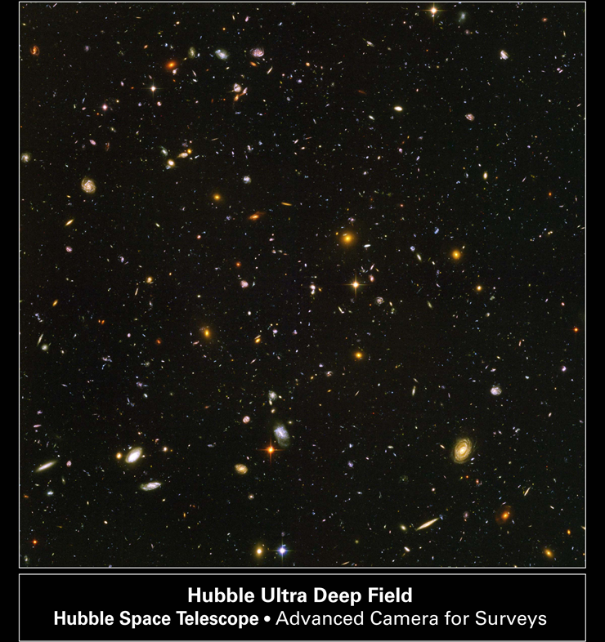

Slide 6
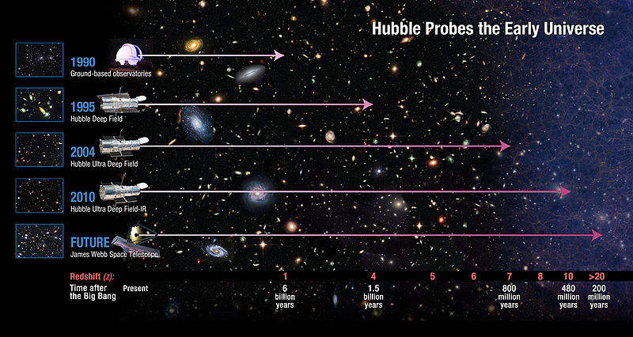

Slide 7
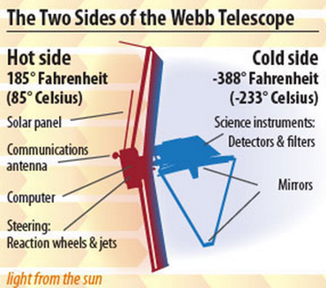
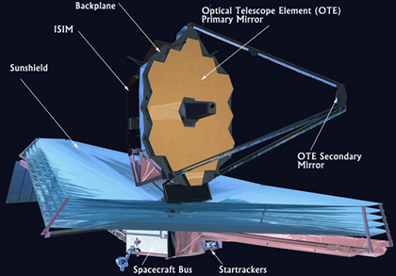
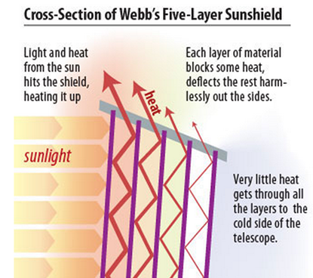
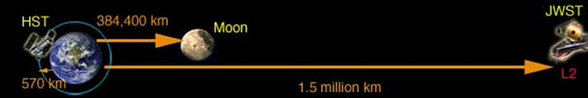
James Webb Space Telescope
James Webb telescope is a large infrared space telescope.
Consists of five main components ;
Near Infrared Spectrograph
Mid Infrared Spectrograph
Near Infrared Camera
“Tennis Court” sized sunshield
Large primary mirror.
Orbit 150 million km from earth at L2 (second Lagrange point).

Slide 8
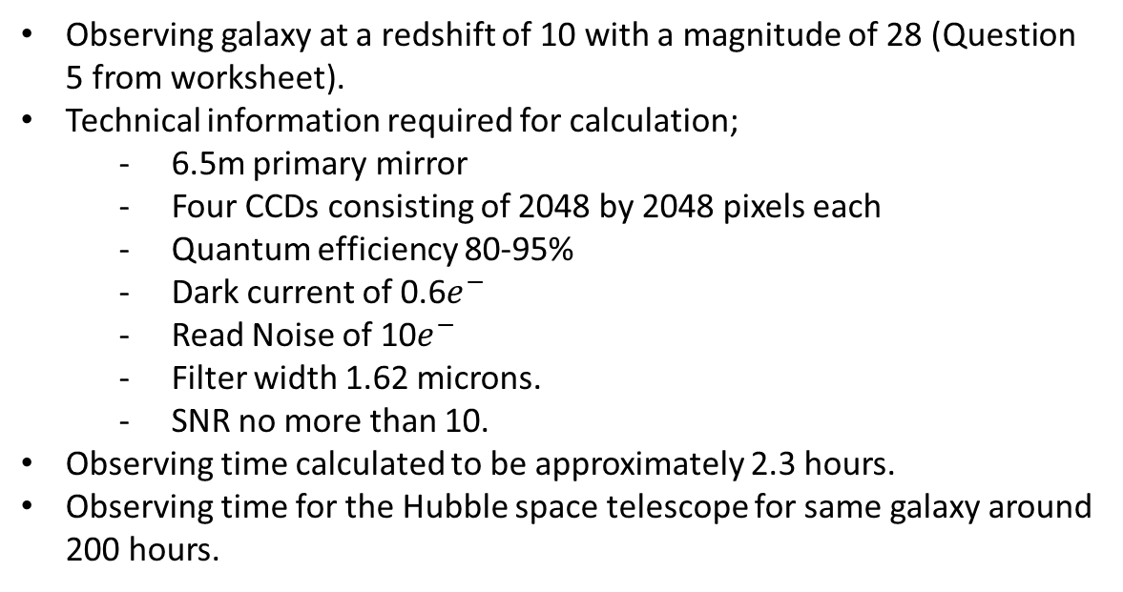
Calculation For Observing Time
Observing galaxy at a redshift of 10 with a magnitude of 28 (Question 5 from worksheet).
Technical information required for calculation;
- 6.5m primary mirror
- Four CCDs consisting of 2048 by 2048 pixels each
- Quantum efficiency 80-95%
- Dark current of 0.6$e^{−}$
- Read Noise of 10$e^{−}$
- Filter width 1.62 microns.
- SNR no more than 10.
Observing time calculated to be approximately 2.3 hours.
Observing time for the Hubble space telescope for same galaxy around 200 hours.

Slide 9
James Webb Space Telescope
Aims
To search for light from the first stars and galaxies
To study the formation and evolution of galaxies
To understand the formation of stars and planetary systems
To study planetary systems and the origins of life

Slide 10


Calculating Observation Time
JWST: t = 2.33 hours

Slide 11

Observation Times
Group Studies - Observing Time Calculations
 | m |  | 28
 | z |  | 10
 | λ(obs) |  | 1.65E-06
 | ν |  | 1.82E+14
 | Energy |  | 1.21E-19
 | Photons per joule |  | 8.30E+18
 | Fν |  | 2.29E-31
 | Fλ |  | 2.52E-24
VLT | Photons |  | 3.04
 | Time (seconds) |  | 2236080.69
 | Time (hours) |  | 621.13
 | Seconds / Exposure |  | 75882.37
 | # of Exposures |  | 29.47
JWST | Filter |  | 0.151
 | Photons |  | 0.84
 | a |  | 0.70
 | b |  | -5877.77
 | c |  | -362113.92
 | Time (seconds) |  | 8402.58
 | Time (Hours) |  | 2.33
 | Seconds / Exposure |  | 8.45E+08
 | # of Exposures |  | 9.95E-06
Hubble | Filter |  | 0.151
 | Photons |  | 0.11
 | a |  | 0.01
 | b |  | -10560.22
 | c |  | -4438939.57
 | Time (seconds) |  | 806743.36
 | Time (Hours) |  | 224.10
 | Seconds / Exposure |  | 4.24E+08
 | # of Exposures |  | 1.90E-03
Background Limited Case
Times
VLT, roughly 620 hours
Hubble, roughly 224 hours
JWST, roughly 2 hours

Slide 12
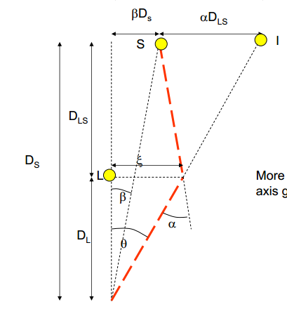
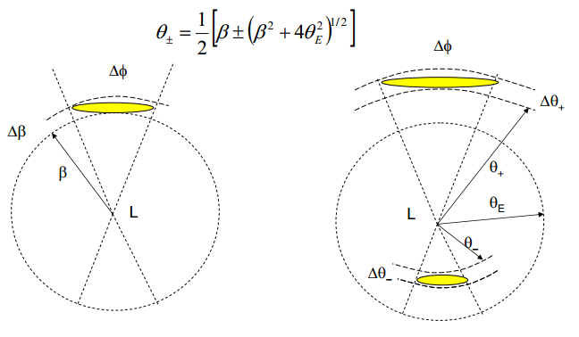
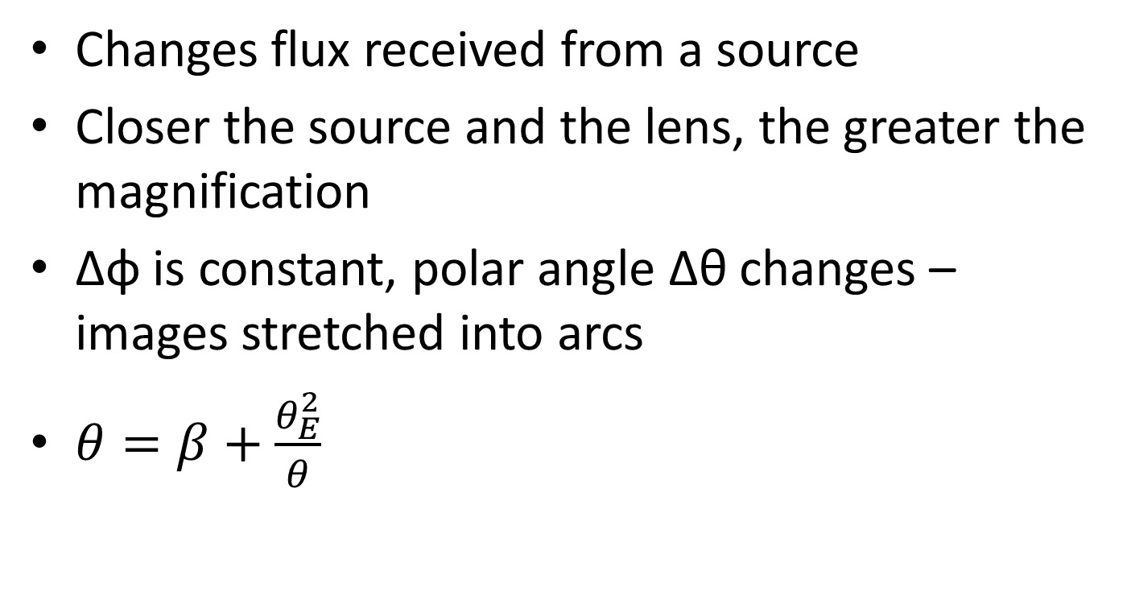
Gravitational Lensing
Changes flux received from a source
Closer the source and the lens, the greater the magnification
Δφ is constant, polar angle Δθ changes – images stretched into arcs
$θ=β+\frac{θ_{E}^{2}}{θ}$

Slide 13
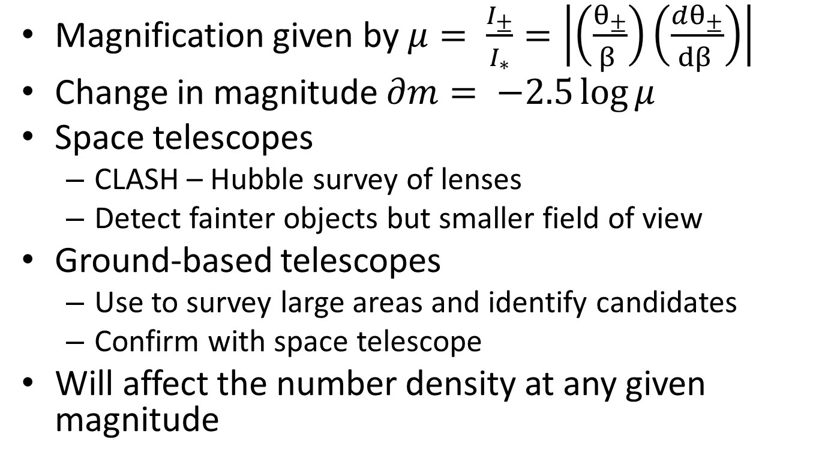
Gravitational Lensing
Magnification given by $μ= \frac{I_{±}}{I_{∗}}=\left|\left(\frac{θ_{±}}{β }\right)\left(\frac{dθ_{±}}{dβ }\right)\right|$
Change in magnitude $∂m= −2.5\log{μ}$
Space telescopes
CLASH – Hubble survey of lenses
Detect fainter objects but smaller field of view
Ground-based telescopes
Use to survey large areas and identify candidates
Confirm with space telescope
Will affect the number density at any given magnitude

